Slide 1
Bank Analysis on IT Customers

Slide 2
Abstract
Our project works on enhancing the business of the bank from the customers who are IT employees.
We analyze the customer interest like deposit, loans, income ,branch availability, the banks ability to attract customers and thereby enhance the net profits of the banks both to increase the transactions of bank from the existing customers as well as to increase the no of customers.

Slide 3
Introduction
Success of banking operations is strongly correlated with the quality of customer relations and efficacy of bank processes.
Bank Seek means for an efficient analysis of vast amount of gathered data from the IT systems.
They are exploiting business intelligence (BI) technology to analyze every aspect of the data to understand interests of their clients , striving to satisfy clients needs , in an endless race for a competitive advantage in the market.

Slide 4
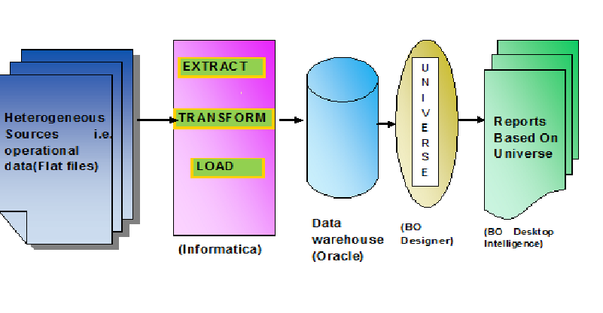
Project Flow

Slide 5
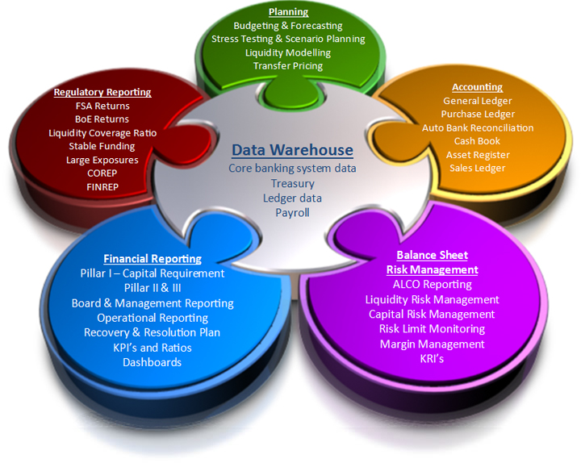
Reporting departments in bank

Slide 6
Tools Requirements
Oracle 9i client and access to oracle 9i server
Informatica 9.5.1
IDT
BOXI R4

Slide 7
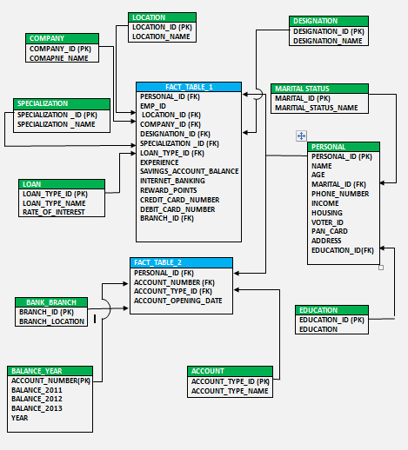
Schema Structure :

Slide 8
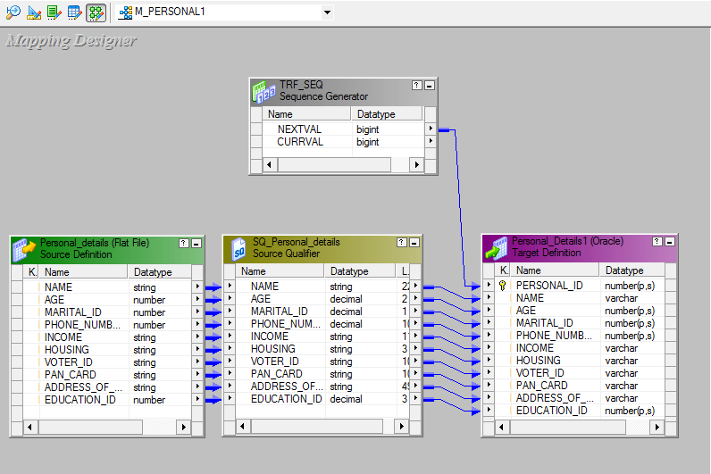

Slide 9
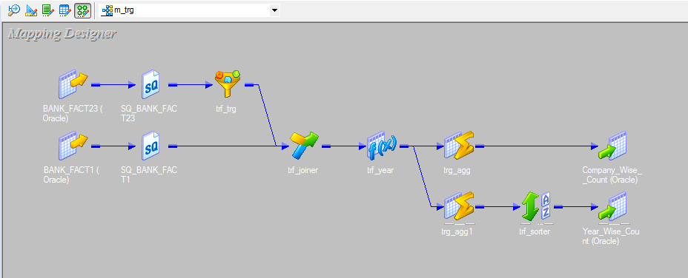

Slide 10
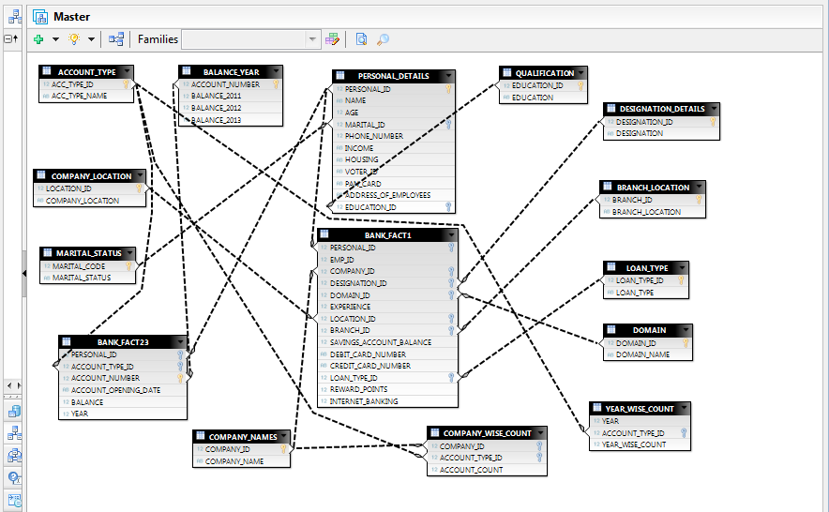
Universe Design

Slide 11
Reports
Company Wise Account Type Count
Bank branch region wise count
Year wise analysis on account opening date
Company wise loan type count
Income tax details of employees
Age analysis for retirement policies
Top ten balance of the oldest customers
Oldest customers
Education wise account count
Age wise analysis
Top ten balance

Slide 12
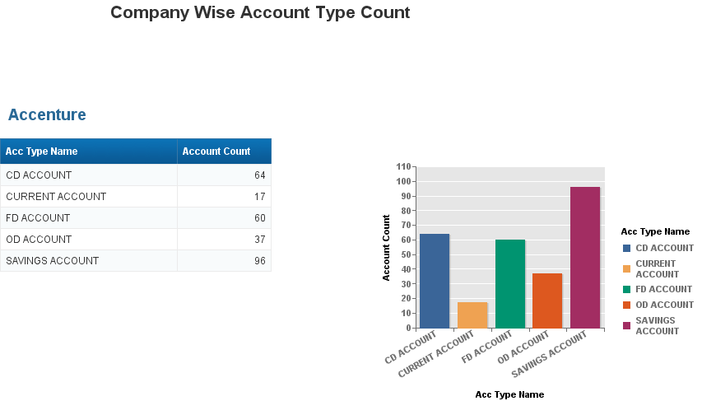

Slide 13
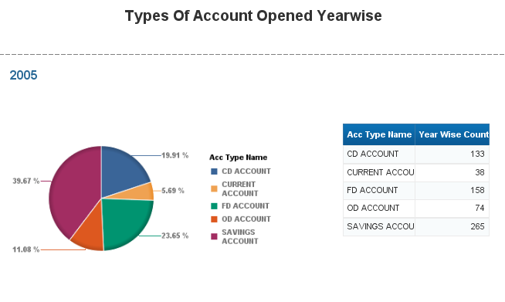

Slide 14
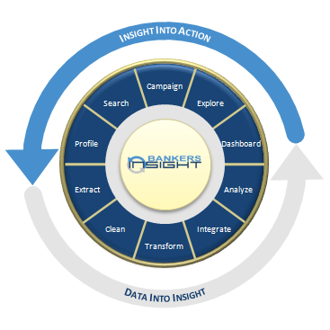
Bankers Insight

Slide 15


Slide 16


